Slide 1
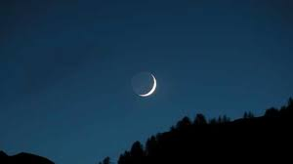
The Eid Moon

Slide 2
I can see the Eid moon shining high Show me where it shines up in the sky From today we’ll sing and play we’ll all be friends together From today we’ll sing and play wel’ll all be friends together I can see the Eid moon shining high Show me where it shines up in the sky

Slide 3
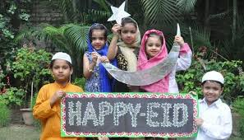
Eid is here again
Eid is here again come and celebrate, come and celebrate, come and celebrate
Eid is here again come and celebrate come and celebrate
Lift your voice in song.
Wearing special clothes come and celebrate, come and celebrate, come and celebrate
Wearing special clothes come and celebrate come and celebrate
Lift your voice in song.
Cooking special food come and celebrate, come and celebrate, come and celebrate
Cooking special food come and celebrate come and celebrate
Lift your voice in song.
Decorate your homes come and celebrate, come and celebrate, come and celebrate
Decorate your homes come and celebrate come and celebrate
Lift your voice in song.
Presents are received come and celebrate, come and celebrate, come and celebrate
Presents are received come and celebrate come and celebrate
Lift your voice in song.

