Slide 1
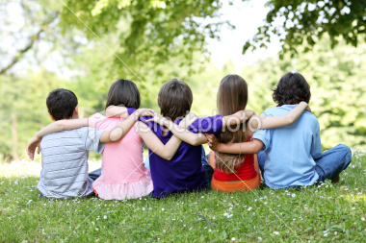
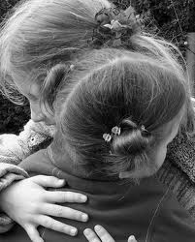
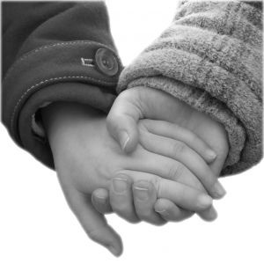
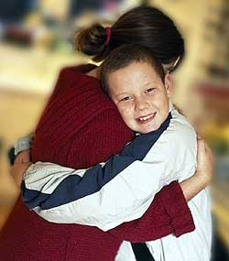
Refuge

Slide 2
There’s always someone standing on their own outside the crowd who looks bewildered and confused.
They try to make some sense of all the jostling and the jokes but still they don’t look that amused.
What place, what life, what did they leave behind?
What sights, what sounds, what thoughts are on their mind?

Slide 3
I’ve noticed that your accent has an unfamiliar sound; sometimes it seems you hate us all.
In silence you retreat into a closed and private world behind your own protective wall.
What crimes, what hurt, what wars have you survived?
What hopes, what dreams were left when you arrived?

Slide 4
Who’ll be your refuge, your shelter, your fortress?
Who’ll be your champion?
Who’ll be your refuge, your pilot, your brother, your northern star?
Who will be your second sight; the light that guides your way at night?
Don’t be down-hearted.
I’ll be your refuge, I’ll be your refuge.

Slide 5
There’s nothing wrong with being shy and ev’rybody knows that fools speak louder than the rest.
(… that fools speak louder than the rest.)
Let no-one tell you how to think or what is right or true: you are not weak or second best.
(… you are not weak or second best.)
What crimes, what hurt, what wars have you survived? (echo)
What hopes, what dreams were left when you arrived? (echo)

Slide 6
I’ll be your refuge, your shelter, your fortress,
I’ll be your champion.
I’ll be your refuge, your pilot, your brother, your northern star.
I will be your second sight; the light that guides your way at night.
Don’t be down-hearted.
I’ll be your refuge, I’ll be your refuge,
I’ll be your refuge. I’ll be your refuge, I’ll be your refuge, refuge.

