Slide 1
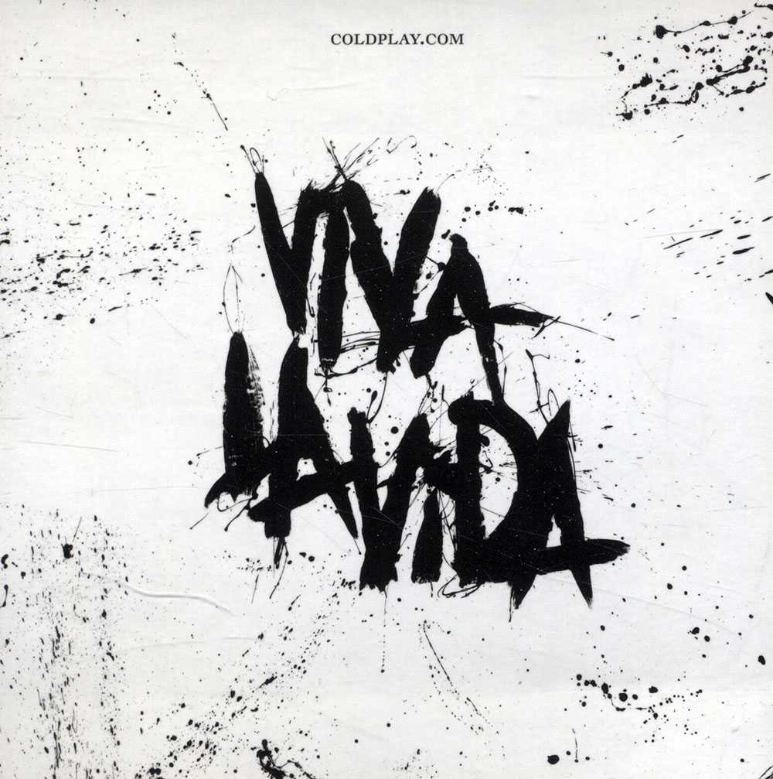
Viva La Vida
Young Voices 2019

Slide 2
I used to rule the world,
Seas would rise when I gave the word,
Now in the morning I sleep alone,
Sweep the streets I used to own.
I used to roll the dice, feel the fear in my enemies’ eyes
Listen as the crowd would sing,
“Now the old king is dead, long live the king,”
One minute I held the key,
Next the walls were closed on me,
And I discovered that my castles stand
Upon pillars of salt and pillars of sand.

Slide 3
I hear Jerusalem bells aringing,
Roman Cavalry choirs are singing,
Be my mirror, my sword and shield,
My missionaries in a foreign field,
For some reason I can’t explain,
I know St Peter won’t call my name,
Never an honest word,
And that was when I ruled the world.

Slide 4
It was a wicked and wild wind,
Blew down the doors to let me in;
Shattered windows and the sound of drums,
People couldn’t believe what I’d become,
Revolutionaries wait,
For my head on a silver plate,
Just a puppet on a lonely string,
Ah, who would ever wanna be king?

Slide 5
I hear Jerusalem bells aringing,
Roman Cavalry choirs are singing,
Be my mirror, my sword and shield,
My missionaries in a foreign field,
For some reason I can’t explain,
I know St Peter won’t call my name,
Never an honest word,
And that was when I ruled the world.
Ah Ah Ah Ah Ah Ah Ah Ah

Slide 6
Ah Ah Ah Ah Ah Ah Ah Ah
I hear Jerusalem bells aringing,
Roman Cavalry choirs are singing,
Be my mirror, my sword and shield,
My missionaries in a foreign field,
For some reason I can’t explain,
I know St Peter won’t call my name,
Never an honest word,
But that was when I ruled the world.
Ooh ooh ooh ooh, ooh ooh ooh ooh

