Slide 1
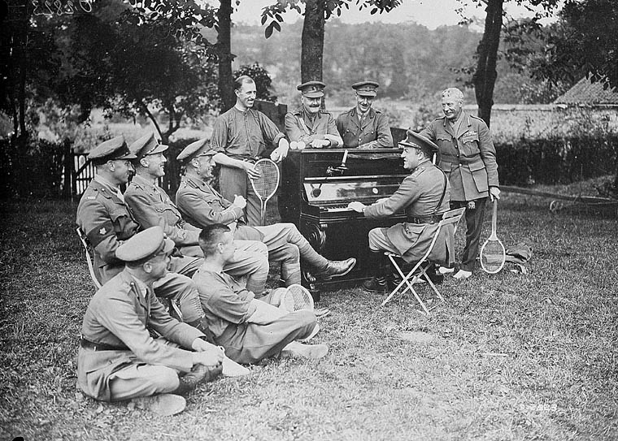
World War One Medley
Singing Spectacular 2019

Slide 2
Hail proud sons of the wheat sheaf, gilded daughters of the rose
Best of Bedfordshire called to arms, ready to fight their foes!
Luton marches off to war,
Hatters and plaiters no more, no more!
Bound for the selfless glory none but the bravest knows.
None but the bravest, none but the bravest,
none but the bravest knows.

Slide 3
Part 1:
Whistling
Goodbye Piccadilly, Farewell Leicester square
Whistling
Part 2:
It’s a long way to Tipperary
It’s a long way to go
It’s a long way to Tipperary
To the sweetest girl I know!
Goodbye Piccadilly, Farewell Leicester square
It’s a long long way to Tipperary
But my heart’s right there!

Slide 4
Goodbye Dolly I must leave you
Though it breaks my heart to go
Something tells me I am needed
At the front to fight the foe
See the soldier boys are marching
And I can no longer stay
Hark I hear the bugle calling
Goodbye Dolly Gray

Slide 5
Good-bye-ee, good-bye-ee
Wipe the tear baby dear, from your eye-ee
Though it’s hard to part, I know
I’ll be tickled to death to go
Don’t cry-ee, don’t sigh-ee!
There’s a silver lining in the sky-ee
Bonsoir old thing!
Cheerio chin chin!
Nah poo! Toodle-oo! Good bye-ee
(Good bye-ee)
Good bye (Good bye-ee)
Toodle-oo (Good bye-ee)
Good bye (Good bye-ee)
Toodle-oo!

Slide 6
Raining, raining, raining,
Always bally well raining
Raining all the morning and raining all the night
Grousing, grousing, grousing,
Always bally well grousing,
Grousing at the rations and grousing at the pay.

Slide 7
Mademoiselle from Armentieres, Parley vous!
Mademoiselle from Armentieres, same to you!
Who was the girl that lost her sheep.
Thro’ singing this chorus in her sleep?
Mademoiselle from Armentieres
Mademoiselle from Armentieres, Parley vous!
Mademoiselle from Armentieres, same to you!
Giddy old Col’nel knows his biz,
And who do you think his batman is?
Mademoiselle from Armentieres

Slide 8
Mademoiselle from Armentieres, Parley vous!
Mademoiselle from Armentieres, same to you!
There with the Man up in the Moon
A-showing the French girls how to spoon
Mademoiselle from Armentieres

Slide 9
Keep the home fires burning
While your hearts are yearning
Though your lads are far away
They dream of Home
There’s a silver lining
Through the dark cloud shining
Turn the dark cloud inside out,
Till the boys come Home

Slide 10
Sister Susie’s sewing shirts for soldiers,
Such skill at sewing shirts our shy young sister Susie shows!
Some soldiers send epistles, say they’d sooner sleep in thistles
Than the saucy, soft, short shirts for soldiers
Sister Susie sews!
(x3 – getting faster each time!)

Slide 11
She was a dear little dicky bird
“Chip, chip, chip,” she went
Sweetly she sang to me
Till all my money was spent;
Then she went off song, we parted on fighting terms
She was one of the early birds and I was one of the worms
Then she went off song, we parted on fighting terms
She was one of the early birds and I was one of the worms

Slide 12
Oh! Every evening hear him sing
It’s the cutest little thing
Got the cutest little swing,
Hitchy Koo, Hitchy Koo.
Oh! Simply meant for kings and queens
Don’t you ask me what it means
I just love lthat Hitchy Koo, Hitchy Koo, Hitchy Koo.
Say, he does it just like no one could
When he does it, say, he does it good

Slide 13
Oh! Every evening hear him sing
It’s the cutest little thing
Got the cutest little swing,
Hitchy Koo, Hitchy Koo.

Slide 14
If I/you were the only girl in the world,
And you/I were the only boy
Nothing else would matter in the world today
We could go on loving in the same old way
A garden of Eden just made for two
With nothing to mar our joy
I would say such wonderful things to you
There would be such wonderful things to do
If I/you were the only girl in the world
And you/I were the only boy.

Slide 15
Pack up your troubles in your old kit bag
And smile, smile, smile
While you’ve a Lucifer to light your fag
Smile boys that’s the style.
What’s the use of worrying? It never was worthwhile
So pack up your troubles in your old kit bag
And smile, smile, smile!

Slide 16
Part 2
Pack up your troubles in your old kit bag
And smile, smile, smile
While you’ve a Lucifer to light your fag
Smile boys that’s the style.
What’s the use of worrying? It never was worthwhile
So pack up your troubles in your old kit bag
And smile, smile, smile!
Part 1
Whistling
Part 3
Hail proud sons of the wheat sheaf, gilded daughters of the rose
Best of Bedfordshire called to arms, ready to fight their foes!
Luton marches off to war,
Hatters and plaiters no more, no more!
Bound for the selfless glory none but the bravest knows.
None but the bravest, none but the bravest,
none but the bravest knows.

